Slide 1
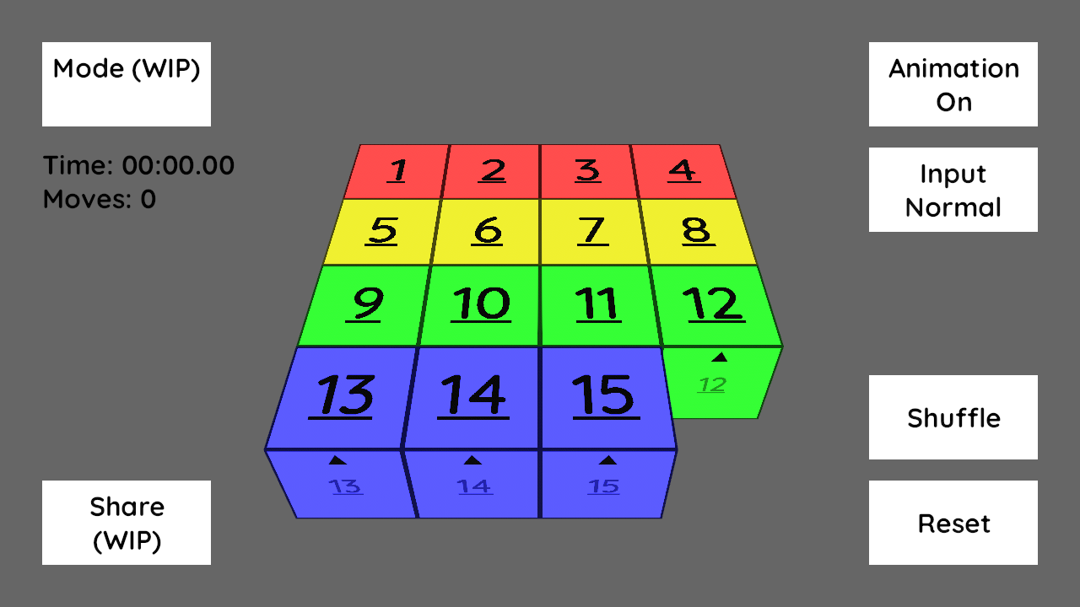
Practice

Slide 2
Time Attack
Show Statistics

Slide 3
Statistics
Solves: 15
Average: X:XX.XX
Best: X:XX.XX Worst: X:XX.XX
Time Attack
Show Statistics
X:XX.XX
X:XX.XX
X:XX.XX
X:XX.XX
X:XX.XX
X:XX.XX
X:XX.XX
X:XX.XX

Slide 4
Daily Puzzle
2023. 1. 5.
Select Date
Rankings

Slide 5
(달력 형태로 날짜 선택)
Daily Puzzle
2023. 1. 5.
Select Date
Rankings

Slide 6
2023. 1. 5.
Your rank: XXth / XX.X%
Daily Puzzle
Time
Moves
2023. 1. 5.
Select Date
X:XX.XX
X:XX.XX
X:XX.XX
X:XX.XX
X:XX.XX
X:XX.XX
X:XX.XX
X:XX.XX
Rankings

